Slide 1
Snack Squad: A Customizable Snack Ordering and DeliveryApp

Slide 2
Description
Purpose:
Snack Squad is a mobile application designed to simplify snack ordering and delivery for users. It offers a platform where customers can browse a variety of snacks, customize their orders, and track delivery in real-time. The app ensures a seamless experience with intuitive navigation and interactive features.
Core Features:
  Seamless User Experience: Easy navigation and attractive user interface designed with Compose UI.
  Customizable Options: Allows users to select snacks and customize their order preferences.
  Delivery Efficiency: Tracks orders from placement to doorstep delivery with real-time updates.

Slide 3
Key Functionalities
1. Login and Registration:
Provides secure login functionality for both users and admin.
New users can sign up with their email and password, while existing users can log in to access their accounts.
Features include password recovery and admin-specific access.
2. Admin Module:
Designed for order management and database integration.
Admins can view all order details, including the Order ID, items, quantities, and delivery addresses, through a centralized dashboard.
3. Main Page Features:
Displays a grid of popular snack options, complete with images and descriptions.
Includes a cart system to facilitate easy snack selection and checkout.
Real-time updates ensure the user is informed of availability and delivery status.

Slide 4
Technical Overview
1. Technology Stack:
  Android Development: Built using Kotlin with Jetpack Compose for modern UI design.
  Room Database: A lightweight SQLite-based database for secure and efficient data storage and management.
2. Core Components:
  Order Tracking System:
  A dynamic UI leverages LazyColumn for listing active and past orders, showcasing order details interactively.
  Real-time order updates and feedback mechanism.
  Snack Catalog Grid:
  Implemented with LazyVerticalGrid, displaying snack images, ratings, and prices.
  Users can directly add items to their cart from the grid.
  User Database Management:
  Utilizes Room database integration for storing user details securely.
  Ensures smooth functionality of login, registration, and profile updates.

Slide 5
Program
ADMIN:
package com.example.snackordering
import android.icu.text.SimpleDateFormat
import android.os.Bundle
import android.util.Log
import androidx.activity.ComponentActivity
import androidx.activity.compose.setContent
import androidx.compose.foundation.Image
import androidx.compose.foundation.layout.*
import androidx.compose.foundation.lazy.LazyColumn
import androidx.compose.foundation.lazy.LazyRow
import androidx.compose.foundation.lazy.items
import androidx.compose.material.MaterialTheme
import androidx.compose.material.Surface
import androidx.compose.material.Text

Slide 6
import androidx.compose.runtime.Composable
import androidx.compose.ui.Modifier
import androidx.compose.ui.graphics.Color
import androidx.compose.ui.layout.ContentScale
import androidx.compose.ui.res.painterResource
import androidx.compose.ui.unit.dp
import androidx.compose.ui.unit.sp
import com.example.snackordering.ui.theme.SnackOrderingTheme
import java.util.*
class AdminActivity : ComponentActivity() {
private lateinit var orderDatabaseHelper: OrderDatabaseHelper
override fun onCreate(savedInstanceState: Bundle?) {
super.onCreate(savedInstanceState)
orderDatabaseHelper = OrderDatabaseHelper(this)
setContent {
SnackOrderingTheme {
Surface(
modifier = Modifier.fillMaxSize(),
color = MaterialTheme.colors.background ) {
val data=orderDatabaseHelper.getAllOrders();
Log.d("swathi" ,data.toString())
val order = orderDatabaseHelper.getAllOrders()
ListListScopeSample(order) }}}}}

Slide 7
@Composable
fun ListListScopeSample(order: List<Order>) {
Image(
painterResource(id = R.drawable.order), contentDescription = "",
alpha =0.5F,
contentScale = ContentScale.FillHeight)
Text(text = "Order Tracking", modifier = Modifier.padding(top = 24.dp, start = 106.dp, bottom = 24.dp ), color = Color.White, fontSize = 30.sp)
Spacer(modifier = Modifier.height(30.dp))
LazyRow(
modifier = Modifier
.fillMaxSize()
.padding(top = 80.dp),
horizontalArrangement = Arrangement.SpaceBetween
){
item {
LazyColumn {
items(order) { order ->
Column(modifier = Modifier.padding(top = 16.dp, start = 48.dp, bottom = 20.dp)) {
Text("Order ID: ${order.id}")
Text("Item: ${order.itemName}")
Text("Quantity: ${order.quantity}")
Text("Address: ${order.address}") }}}}}}

Slide 8
LOGIN:
package com.example.snackordering
import android.content.Context
import android.content.Intent
import android.os.Bundle
import androidx.activity.ComponentActivity
import androidx.activity.compose.setContent
import androidx.compose.foundation.Image
import androidx.compose.foundation.layout.*
import androidx.compose.material.*
import androidx.compose.runtime.*
import androidx.compose.ui.Alignment
import androidx.compose.ui.Modifier
import androidx.compose.ui.graphics.Color
import androidx.compose.ui.layout.ContentScale
import androidx.compose.ui.res.painterResource
import androidx.compose.ui.text.font.FontFamily
import androidx.compose.ui.text.font.FontWeight
import androidx.compose.ui.unit.dp
import androidx.compose.ui.unit.sp
import androidx.core.content.ContextCompat
import com.example.snackordering.ui.theme.SnackOrderingTheme
class LoginActivity : ComponentActivity() {
private lateinit var databaseHelper: UserDatabaseHelper
override fun onCreate(savedInstanceState: Bundle?) {
super.onCreate(savedInstanceState)

Slide 9
databaseHelper = UserDatabaseHelper(this)
setContent {
SnackOrderingTheme {
Surface(
modifier = Modifier.fillMaxSize(),
color = MaterialTheme.colors.background
) {
LoginScreen(this, databaseHelper)
}}}}}
@Composable
fun LoginScreen(context: Context, databaseHelper: UserDatabaseHelper) {
Image(painterResource(id = R.drawable.order), contentDescription = "",
alpha =0.3F,
contentScale = ContentScale.FillHeight,)
var username by remember { mutableStateOf("") }
var password by remember { mutableStateOf("") }
var error by remember { mutableStateOf("") }
Column(
modifier = Modifier.fillMaxSize(),
horizontalAlignment = Alignment.CenterHorizontally,
verticalArrangement = Arrangement.Center
) {

Slide 10
Text(
fontSize = 36.sp,
fontWeight = FontWeight.ExtraBold,
fontFamily = FontFamily.Monospace,
color = Color.White,
text = "Login"
)
Spacer(modifier = Modifier.height(10.dp))
TextField(
value = username,
onValueChange = { username = it },
label = { Text("Username") },
modifier = Modifier.padding(10.dp)
.width(280.dp)
)
TextField(
value = password,
onValueChange = { password = it },
label = { Text("Password") },
modifier = Modifier.padding(10.dp)
.width(280.dp) )
if (error.isNotEmpty()) {
Text(
text = error,
color = MaterialTheme.colors.error,
modifier = Modifier.padding(vertical = 16.dp) )}

Slide 11
Button(
onClick = {
if (username.isNotEmpty() && password.isNotEmpty()) {
val user = databaseHelper.getUserByUsername(username)
if (user != null && user.password == password) {
error = "Successfully log in"
context.startActivity(
Intent(
context,
MainPage::class.java
))}
if (user != null && user.password == "admin") {
error = "Successfully log in"
context.startActivity(
Intent(
context,
AdminActivity::class.java ))}
else {
error = "Invalid username or password"
}
} else {
error = "Please fill all fields"
}
},
modifier = Modifier.padding(top = 16.dp)
) {

Slide 12
Text(text = "Login")
}
Row {
TextButton(onClick = {context.startActivity(
Intent(
context,
MainActivity::class.java
)
)}
)
{ Text(color = Color.White,text = "Sign up") }
TextButton(onClick = {
})
{
Spacer(modifier = Modifier.width(60.dp))
Text(color = Color.White,text = "Forget password?") }}}}
private fun startMainPage(context: Context) {
val intent = Intent(context, MainPage::class.java)
ContextCompat.startActivity(context, intent, null)
}

Slide 13
MAIN PAGE:
package com.example.snackordering
import android.annotation.SuppressLint
import android.content.Context
import android.os.Bundle
import android.widget.Toast
import androidx.activity.ComponentActivity
import androidx.activity.compose.setContent
import androidx.annotation.DrawableRes
import androidx.annotation.StringRes
import androidx.compose.foundation.Image
import androidx.compose.foundation.background
import androidx.compose.foundation.layout.*
import androidx.compose.foundation.shape.CircleShape
import androidx.compose.foundation.shape.RoundedCornerShape
import androidx.compose.material.*
import androidx.compose.material.icons.Icons
import androidx.compose.material.icons.filled.*
import androidx.compose.runtime.Composable
import androidx.compose.ui.Alignment
import androidx.compose.ui.Modifier
import androidx.compose.ui.draw.clip
import androidx.compose.ui.graphics.Color
import androidx.compose.foundation.lazy.LazyColumn
import androidx.compose.foundation.lazy.items
import androidx.compose.material.Text
import androidx.compose.ui.unit.dp

Slide 14
import androidx.compose.ui.graphics.RectangleShape
import androidx.compose.ui.layout.ContentScale
import androidx.compose.ui.platform.LocalContext
import androidx.compose.ui.res.painterResource
import androidx.compose.ui.res.stringResource
import androidx.compose.ui.text.font.FontWeight
import androidx.compose.ui.unit.sp
import androidx.core.content.ContextCompat.startActivity
import com.example.snackordering.ui.theme.SnackOrderingTheme
import android.content.Intent as Intent1
import androidx.compose.foundation.lazy.grid.GridCells
import androidx.compose.foundation.lazy.grid.LazyVerticalGrid
import androidx.compose.foundation.lazy.grid.items
class MainPage : ComponentActivity() {
override fun onCreate(savedInstanceState: Bundle?) {
super.onCreate(savedInstanceState)
setContent {
SnackOrderingTheme {
// A surface container using the 'background' color from the theme
Surface(
modifier = Modifier.fillMaxSize(),
color = MaterialTheme.colors.background
) {
FinalView(this)
val context = LocalContext.current
//PopularFoodColumn(context)
}}}}

Slide 15
@Composable
fun TopPart() {
Row(
modifier = Modifier
.fillMaxWidth()
.background(Color(0xffeceef0)), Arrangement.SpaceBetween ){
Icon(
imageVector = Icons.Default.Menu, contentDescription = "Menu Icon",
Modifier
.clip(CircleShape)
.size(40.dp),
tint = Color.Black,)
Column(horizontalAlignment = Alignment.CenterHorizontally) {
Text(text = "Location", style = MaterialTheme.typography.subtitle1, color = Color.Black)
Row {
Icon(
imageVector = Icons.Default.LocationOn,
contentDescription = "Location",
tint = Color.Red,)
Text(text = "Coimbatore" , color = Color.Black)}}
Icon(
imageVector = Icons.Default.Notifications, contentDescription = "Notification Icon",
Modifier
.size(45.dp),
tint = Color.Black,
)}}

Slide 16
@Composable
fun PopularFood(
@DrawableRes drawable: Int,
@StringRes text1: Int,
context: Context
) {
Card(
modifier = Modifier
.padding(top=20.dp, bottom = 20.dp, start = 65.dp)
.width(250.dp)
) {
Column(
verticalArrangement = Arrangement.Top,
horizontalAlignment = Alignment.CenterHorizontally
) {
Spacer(modifier = Modifier.padding(vertical = 5.dp))
Row(
modifier = Modifier
.fillMaxWidth(0.7f), Arrangement.End
) {
Icon(
imageVector = Icons.Default.Star,
contentDescription = "Star Icon",
tint = Color.Yellow
)
Text(text = "5.0", fontWeight = FontWeight.Black)
}

Slide 17
Image(
painter = painterResource(id = drawable),
contentDescription = "Food Image",
contentScale = ContentScale.Crop,
modifier = Modifier
.size(100.dp)
.clip(CircleShape))
Text(text = stringResource(id = text1), fontWeight = FontWeight.Bold)
Row(modifier = Modifier.fillMaxWidth(0.7f), Arrangement.SpaceBetween) {
/*TODO Implement Prices for each card*/
Text(
text = "Rs.40",
style = MaterialTheme.typography.h6,
fontWeight = FontWeight.Bold,
fontSize = 18.sp)
IconButton(onClick = {
val intent = Intent1(context, TargetActivity::class.java)
context.startActivity(intent)
}) {
Icon(
imageVector = Icons.Default.ShoppingCart,
contentDescription = "shopping cart",
)
}
}
}
}

Slide 18
private val FoodList = listOf(
R.drawable.sandwish to R.string.sandwich,
R.drawable.burger to R.string.burgers,
R.drawable.pasta to R.string.pasta,
R.drawable.tequila to R.string.tequila,
R.drawable.wine to R.string.wine,
R.drawable.salad to R.string.salad,
R.drawable.pop to R.string.popcorn
).map { DrawableStringPair(it.first, it.second) }
private data class DrawableStringPair(
@DrawableRes val drawable: Int,
@StringRes val text1: Int)
@Composable
fun App(context: Context) {
Column(
modifier = Modifier
.fillMaxSize()
.background(Color(0xffeceef0))
.padding(10.dp),
verticalArrangement = Arrangement.Top,
horizontalAlignment = Alignment.CenterHorizontally
) {
Surface(modifier = Modifier, elevation = 5.dp) {
TopPart()
}
Spacer(modifier = Modifier.padding(10.dp))

Slide 19
Spacer(modifier = Modifier.padding(10.dp))
Row(modifier = Modifier.fillMaxWidth(), Arrangement.SpaceBetween) {
Text(text = "Popular Food", style = MaterialTheme.typography.h5, color = Color.Black)}
Spacer(modifier = Modifier.padding(10.dp))
PopularFoodColumn(context) // <- call the function with parentheses }}
@Composable
fun PopularFoodColumn(context: Context) {
LazyVerticalGrid(
columns = GridCells.Fixed(2), // 2 columns
modifier = Modifier
.fillMaxSize()
.padding(1.dp), // Add padding for spacing
contentPadding = PaddingValues(1.dp), // Space around the grid
horizontalArrangement = Arrangement.spacedBy(1.dp), // Space between columns
verticalArrangement = Arrangement.spacedBy(1.dp) // Space between rows ){
items(FoodList) { item ->
PopularFood(
context = context,
drawable = item.drawable,
text1 = item.text1 )}}}
@SuppressLint("UnusedMaterialScaffoldPaddingParameter")
@Composable
fun FinalView(mainPage: MainPage) {
SnackOrderingTheme {
Scaffold() {
val context = LocalContext.current
App(context) }}}

Slide 20
ORDER:
package com.example.snackordering
import androidx.room.ColumnInfo
import androidx.room.Entity
import androidx.room.PrimaryKey
@Entity(tableName = "order_table")
data class Order(
@PrimaryKey(autoGenerate = true) val id: Int?,
@ColumnInfo(name = "Item") val itemName: String?,
@ColumnInfo(name = "quantity") val quantity: String?,
@ColumnInfo(name = "address") val address: String?,
)
package com.example.snackordering
import androidx.room.ColumnInfo
import androidx.room.Entity
import androidx.room.PrimaryKey
@Entity(tableName = "order_table")
data class Order(
@PrimaryKey(autoGenerate = true) val id: Int?,
@ColumnInfo(name = "Item") val itemName: String?,
@ColumnInfo(name = "quantity") val quantity: String?,
@ColumnInfo(name = "address") val address: String?,
)

Slide 21
REGISTER:
package com.example.snackordering
import android.content.Context
import android.content.Intent
import android.os.Bundle
import androidx.activity.ComponentActivity
import androidx.activity.compose.setContent
import androidx.compose.foundation.Image
import androidx.compose.foundation.layout.*
import androidx.compose.material.*
import androidx.compose.runtime.*
import androidx.compose.ui.Alignment
import androidx.compose.ui.Modifier
import androidx.compose.ui.graphics.Color
import androidx.compose.ui.layout.ContentScale
import androidx.compose.ui.res.painterResource
import androidx.compose.ui.text.font.FontFamily
import androidx.compose.ui.text.font.FontWeight
import androidx.compose.ui.unit.dp
import androidx.compose.ui.unit.sp
import androidx.core.content.ContextCompat
import com.example.snackordering.ui.theme.SnackOrderingTheme
class MainActivity : ComponentActivity() {
private lateinit var databaseHelper: UserDatabaseHelper
override fun onCreate(savedInstanceState: Bundle?) {
super.onCreate(savedInstanceState)

Slide 22
databaseHelper = UserDatabaseHelper(this)
setContent {
SnackOrderingTheme {
// A surface container using the 'background' color from the theme
Surface(
modifier = Modifier.fillMaxSize(),
color = MaterialTheme.colors.background
) {
RegistrationScreen(this,databaseHelper) }}}}}
@Composable
fun RegistrationScreen(context: Context, databaseHelper: UserDatabaseHelper) {
Image(
painterResource(id = R.drawable.order), contentDescription = "",
alpha =0.3F,
contentScale = ContentScale.FillHeight,)
var username by remember { mutableStateOf("") }
var password by remember { mutableStateOf("") }
var email by remember { mutableStateOf("") }
var error by remember { mutableStateOf("") }

Slide 23
Column(
modifier = Modifier.fillMaxSize(),
horizontalAlignment = Alignment.CenterHorizontally,
verticalArrangement = Arrangement.Center
) {
Text(
fontSize = 36.sp,
fontWeight = FontWeight.ExtraBold,
fontFamily = FontFamily.Cursive,
color = Color.White,
text = "Register"
)
Spacer(modifier = Modifier.height(10.dp))
TextField(
value = username,
onValueChange = { username = it },
label = { Text("Username") },
modifier = Modifier
.padding(10.dp)
.width(280.dp))
TextField(
value = email,
onValueChange = { email = it },
label = { Text("Email") },
modifier = Modifier
.padding(10.dp)
.width(280.dp) )

Slide 24
TextField(
value = password,
onValueChange = { password = it },
label = { Text("Password") },
modifier = Modifier
.padding(10.dp)
.width(280.dp)
)
if (error.isNotEmpty()) {
Text(
text = error,
color = MaterialTheme.colors.error,
modifier = Modifier.padding(vertical = 16.dp)
)
}
Button(
onClick = {
if (username.isNotEmpty() && password.isNotEmpty() && email.isNotEmpty()) {
val user = User(
id = null,
firstName = username,
lastName = null,
email = email,
password = password
)
databaseHelper.insertUser(user)
error = "User registered successfully"

Slide 25
// Start LoginActivity using the current context
context.startActivity(
Intent(
context,
LoginActivity::class.java ))
} else {
error = "Please fill all fields“ }}
modifier = Modifier.padding(top = 16.dp)
) {
Text(text = "Register“) }
Spacer(modifier = Modifier.width(10.dp))
Spacer(modifier = Modifier.height(10.dp))
Row() {
Text(
modifier = Modifier.padding(top = 14.dp), text = "Have an account?"
)
TextButton(onClick = {
context.startActivity(
Intent(
context,
LoginActivity::class.java ))})
modifier = Modifier.width(10.dp))
Text(text = "Log in") }}}}
private fun startLoginActivity(context: Context) {
val intent = Intent(context, LoginActivity::class.java)
ContextCompat.startActivity(context, intent, null)
}

Slide 26
TARGET:
class TargetActivity : ComponentActivity() {
private lateinit var orderDatabaseHelper: OrderDatabaseHelper
override fun onCreate(savedInstanceState: Bundle?) {
super.onCreate(savedInstanceState)
orderDatabaseHelper = OrderDatabaseHelper(this)
setContent {
SnackOrderingTheme {
// A surface container using the 'background' color from the theme
Surface(
modifier = Modifier
.fillMaxSize()
.background(Color.White)
) {
Order(this, orderDatabaseHelper)
val orders = orderDatabaseHelper.getAllOrders()
Log.d("swathi", orders.toString()) }}}}}
@Composable
fun Order(context: Context, orderDatabaseHelper: OrderDatabaseHelper){
Image(painterResource(id = R.drawable.order), contentDescription = "",
alpha =0.5F,
contentScale = ContentScale.FillHeight)
Column(
horizontalAlignment = Alignment.CenterHorizontally,
verticalArrangement = Arrangement.Center) {

Slide 27
val mContext = LocalContext.current
var quantity by remember { mutableStateOf("") }
var ItemName by remember { mutableStateOf("") }
var address by remember { mutableStateOf("") }
var error by remember { mutableStateOf("") }
TextField(value = ItemName, onValueChange = {ItemName=it},
label = { Text("Item") },
modifier = Modifier
.padding(10.dp)
.width(280.dp))
Spacer(modifier = Modifier.padding(10.dp))
TextField(value = quantity, onValueChange = {quantity=it},
label = { Text("Quantity") },
keyboardOptions = KeyboardOptions(keyboardType = KeyboardType.Number),
modifier = Modifier
.padding(10.dp)
.width(280.dp))
Spacer(modifier = Modifier.padding(10.dp))
TextField(value = address, onValueChange = {address=it},
label = { Text("Address") },
modifier = Modifier
.padding(10.dp)
.width(280.dp))
Spacer(modifier = Modifier.padding(10.dp))
if (error.isNotEmpty()) {
Text(
text = error,

Slide 28
color = MaterialTheme.colors.error,
modifier = Modifier.padding(vertical = 16.dp)
)
}
Button(onClick = {
if( quantity.isNotEmpty() and address.isNotEmpty()){
val order = Order(
id = null,
itemName = ItemName,
quantity = quantity,
address = address
)
orderDatabaseHelper.insertOrder(order)
Toast.makeText(mContext, "Order Placed Successfully", Toast.LENGTH_SHORT).show()}
},
colors = ButtonDefaults.buttonColors(backgroundColor = Color.White))
{
Text(text = "Order Place", color = Color.Black)
}
}
}
private fun startMainPage(context: Context) {
val intent = Intent(context, LoginActivity::class.java)
ContextCompat.startActivity(context, intent, null)
}

Slide 29
USER:
package com.example.snackordering
import androidx.room.ColumnInfo
import androidx.room.Entity
import androidx.room.PrimaryKey
@Entity(tableName = "user_table")
data class User(
@PrimaryKey(autoGenerate = true) val id: Int?,
@ColumnInfo(name = "first_name") val firstName: String?,
@ColumnInfo(name = "last_name") val lastName: String?,
@ColumnInfo(name = "email") val email: String?,
@ColumnInfo(name = "password") val password: String?,
)
package com.example.snackordering
import androidx.room.*
@Dao
interface UserDao {
@Query("SELECT * FROM user_table WHERE email = :email")
suspend fun getUserByEmail(email: String): User?
@Insert(onConflict = OnConflictStrategy.REPLACE)
suspend fun insertUser(user: User)
@Update
suspend fun updateUser(user: User)
@Delete
suspend fun deleteUser(user: User)
}

Slide 30
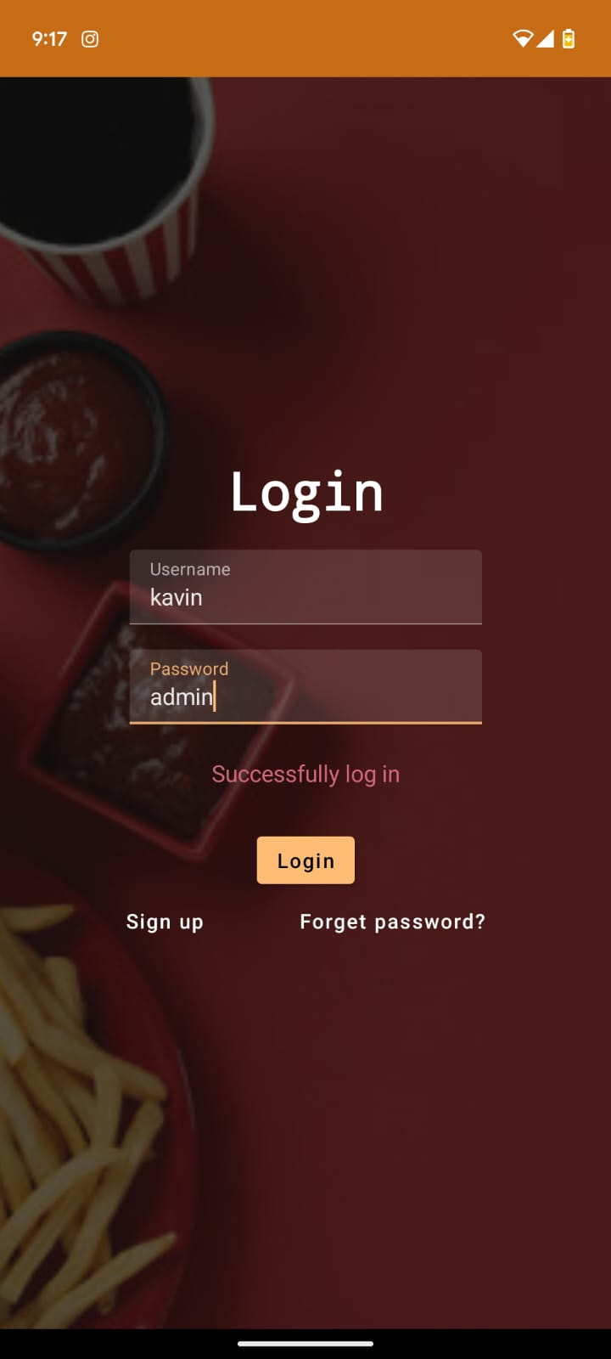
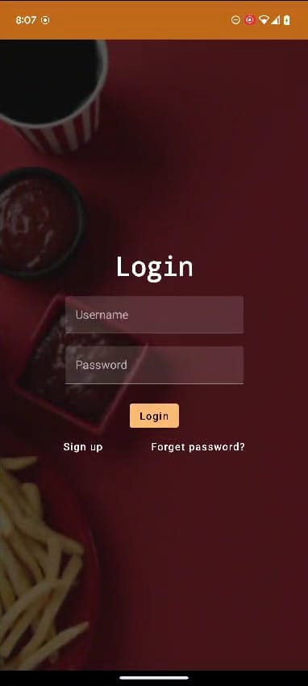
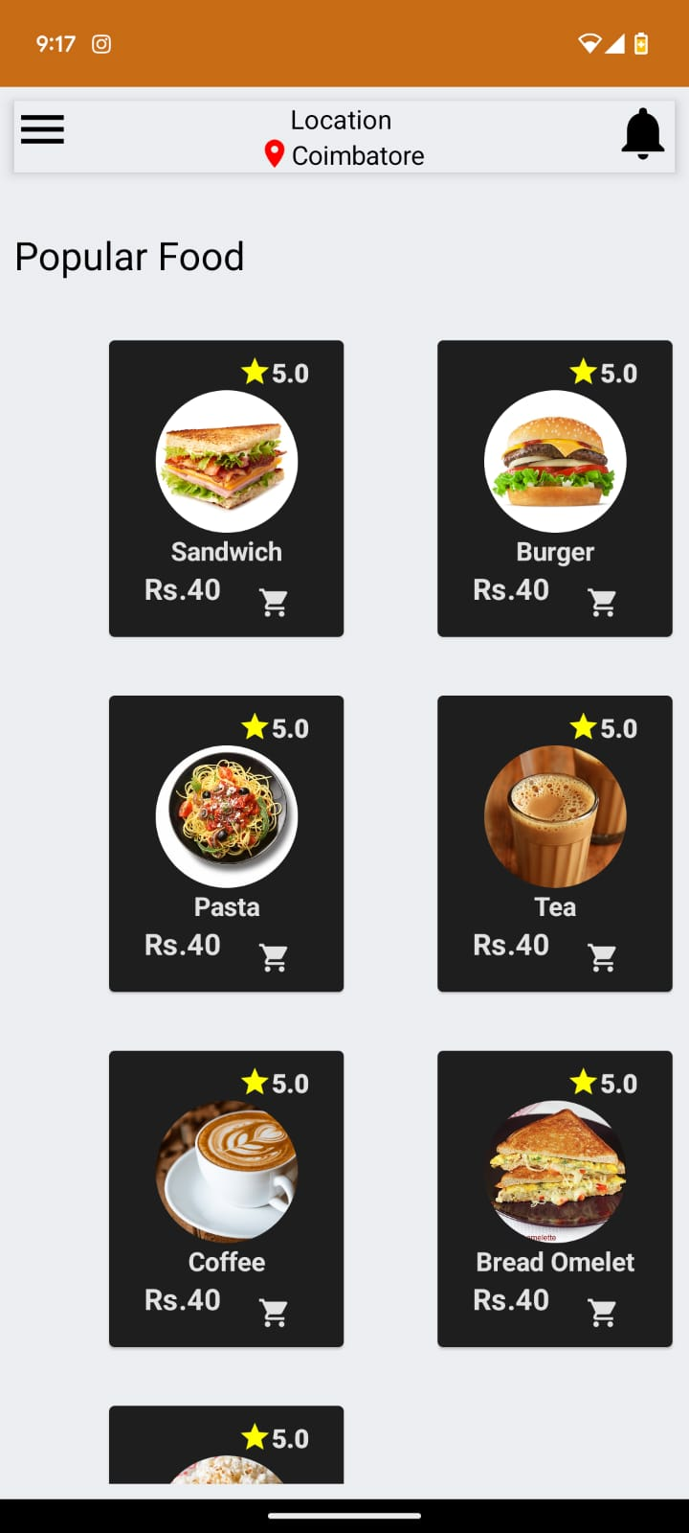
Output
ADMIN LOGIN MAIN PAGE

Slide 31
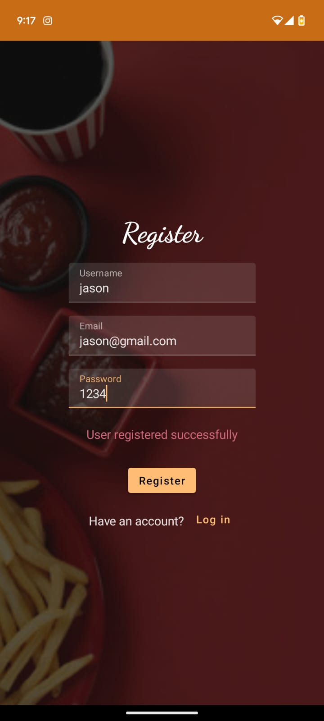
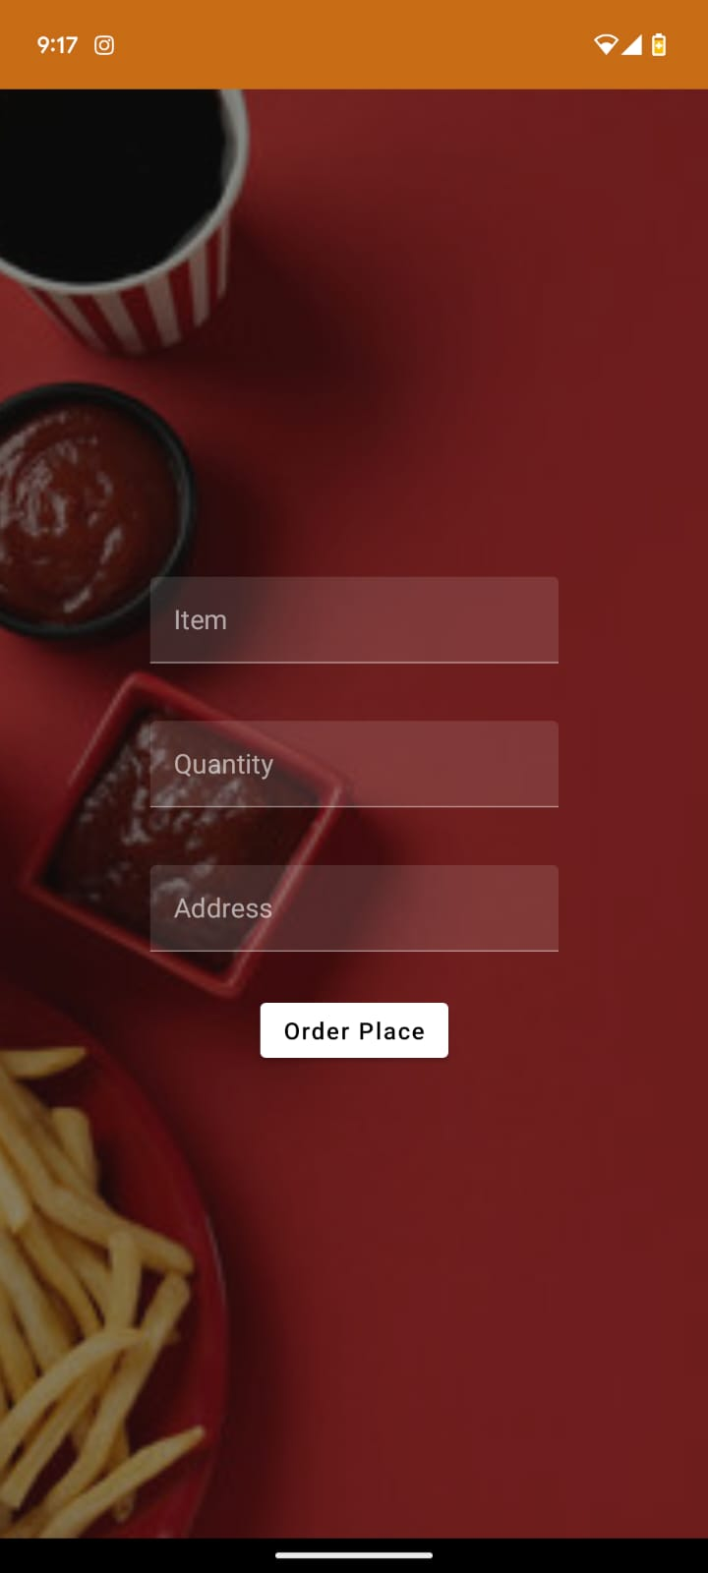
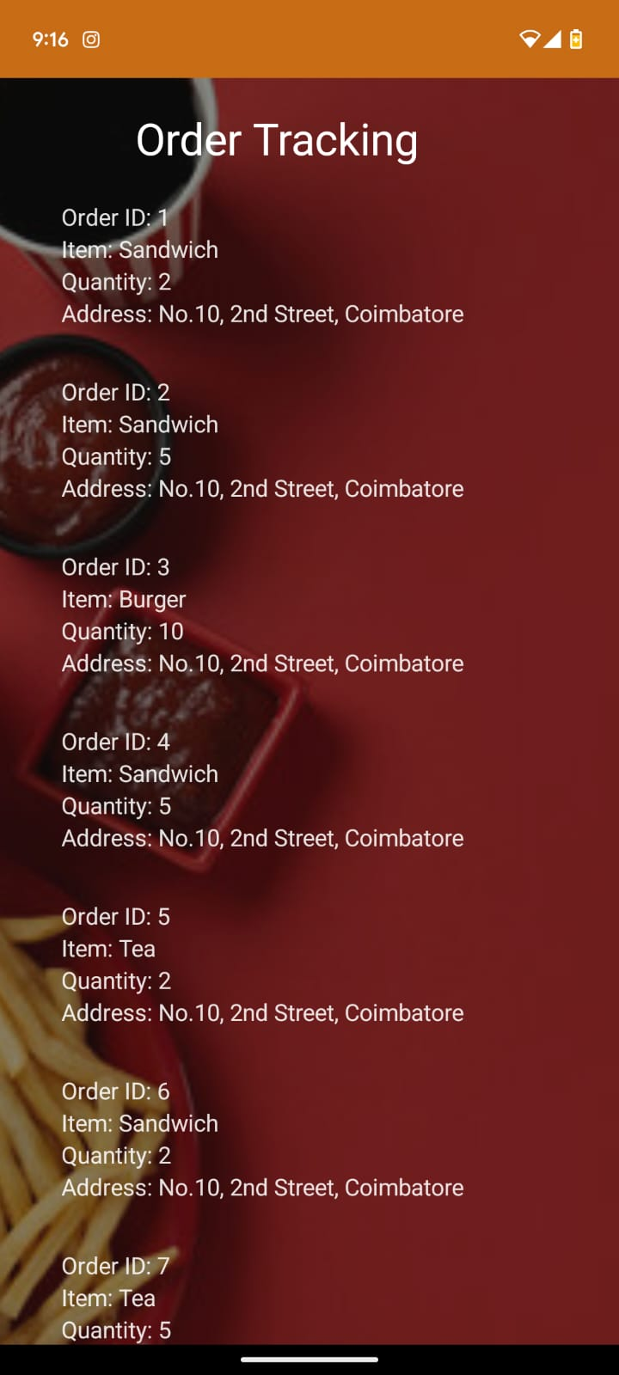
Output
          REGISTER ORDERS ORDER TRACKING

